Slide 1
Step By Step Guide to Request and Redeem your NetAcad Certification Exam Discount
Networking Academy
Program Services
October 2020

Slide 2

Cisco Certification Exam Discount Process
1. Establish your eligibility
Receive Discount Eligibility email notification
Verify your name and email address in NetAcad.com profile
2. Request your discount
Click Request Discount button
Track your Request Status through your profile
3. Verify your data
Click link in email to confirm discount request & validate info
4. Register for your exam and redeem your discount
Setup password recovery phone number
Enter address, verify name and click submit
Receive Cisco certification tracking system login email (no action required)
Receive Cisco exam discount information and instructions
Follow prompts to register for exam at Pearson VUE
Schedule your exam using promo code & pay remaining balance
Receive testing date confirmation & exam day information
8
days
3 - 5 days

Slide 3
Tips to Receive Your Discount
Make sure your data in your NetAcad.com profile is up-to-date, especially your name and email address.
Do not register with Pearson VUE until you have received your discount details which may take up to 5 days after you verify your email address.
When you register with Pearson VUE, make sure you enter your account details exactly as they appear on your Exam Discount Information email from Cisco. You will only be able to access the exam discount using the profile associated with the CSCO ID provided in the email.
If you already have an account at Pearson VUE, click the login button. Do not create a new account.
Reach out for support when you need it. You can find more details within the Discount FAQs.

Slide 4
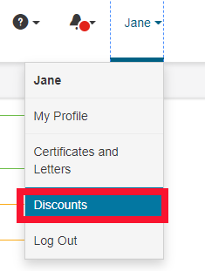

Where do I find my NetAcad Certification Exam Discount?
Login to netacad.com
Click the drop down next to your name
Click Discounts
OR click the blue alert at the top of the page

Slide 5
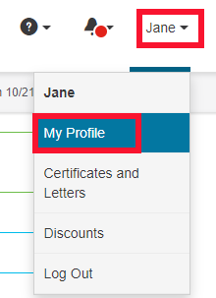
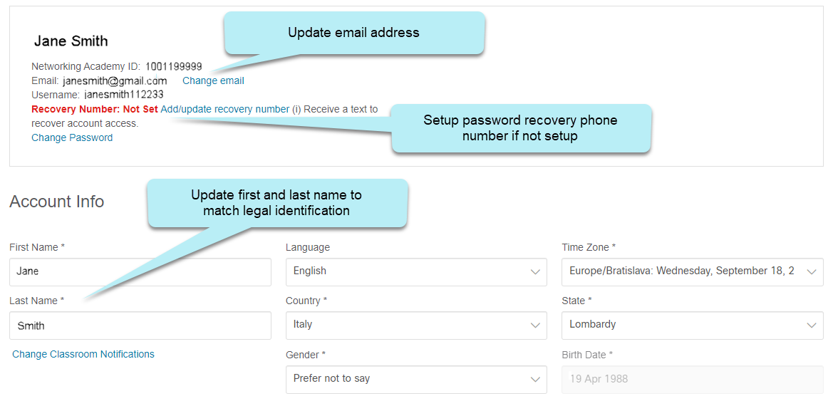
Verify your details in NetAcad.com
Click My Profile in the menu under your name
Verify email address is correct
Setup password recovery phone number
Verify name matches legal identification

Slide 6

Password Recovery Number in OneID
If there is a red alert at the top of the discount screen, you will need to register a password recovery phone number in your OneID profile before you can request the discount.

Slide 7
Steps to Request & Redeem your NetAcad Certification Exam Discount

Slide 8
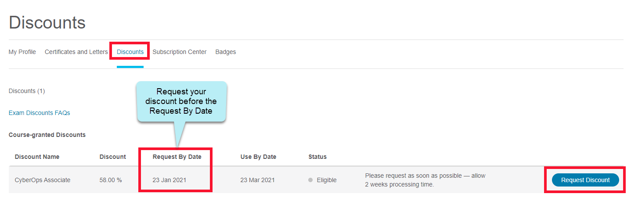
1. View NetAcad Certification Exam Discount in NetAcad.com
Click Discounts
Click Request Discount button

Slide 9
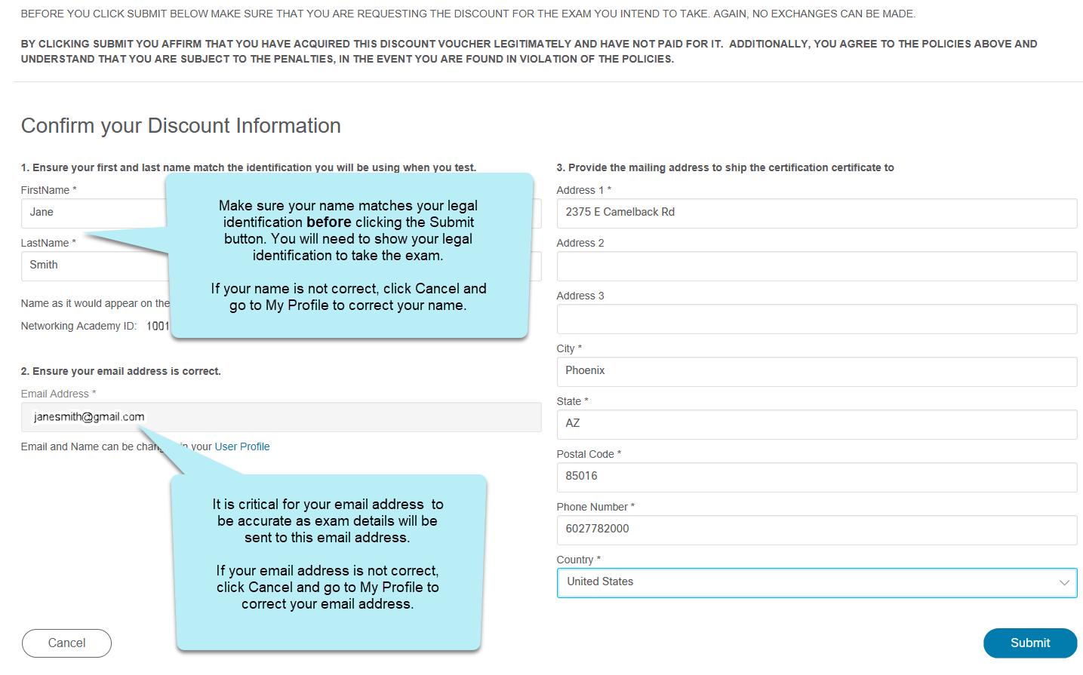
2. Request NetAcad Certification Exam Discount in NetAcad.com
1. Confirm name matches legal identification
Review information and click Submit
3. Enter Address and Phone Number
2. Confirm email address

Slide 10
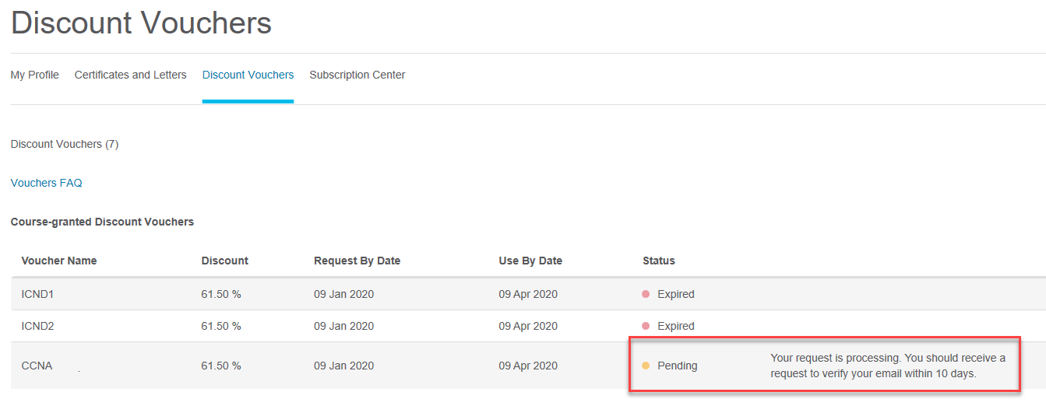
3. NetAcad Certification Exam Discount Processing Period
You will receive an email verification in about 10 days
Track Status of Discount on Discounts page

Slide 11
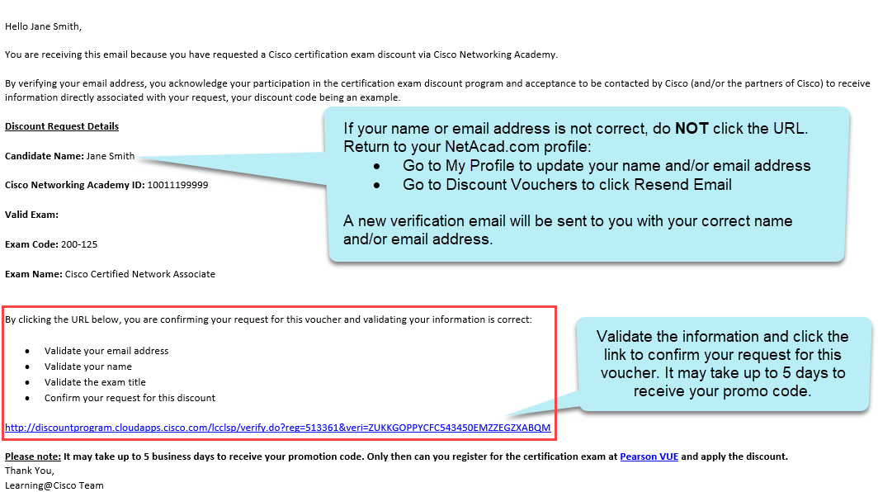
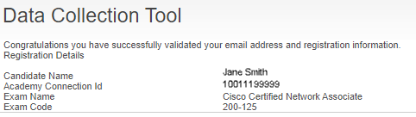
4. Email Verification
Validate name matches legal identification
Validate your email address
Validate the exam title
Click URL to confirm your discount request
Data Collection Tool confirms registration information

Slide 12

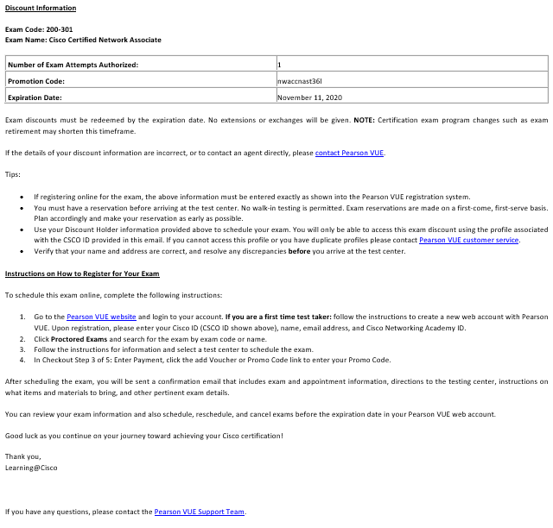
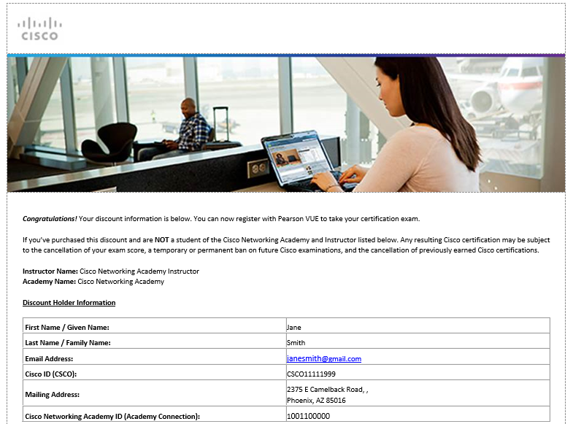
5. NetAcad Certification Exam Discount Email
Receive Discount details Email
Review Discount Information
Review Tips
Read Instructions to register for your exam

Slide 13
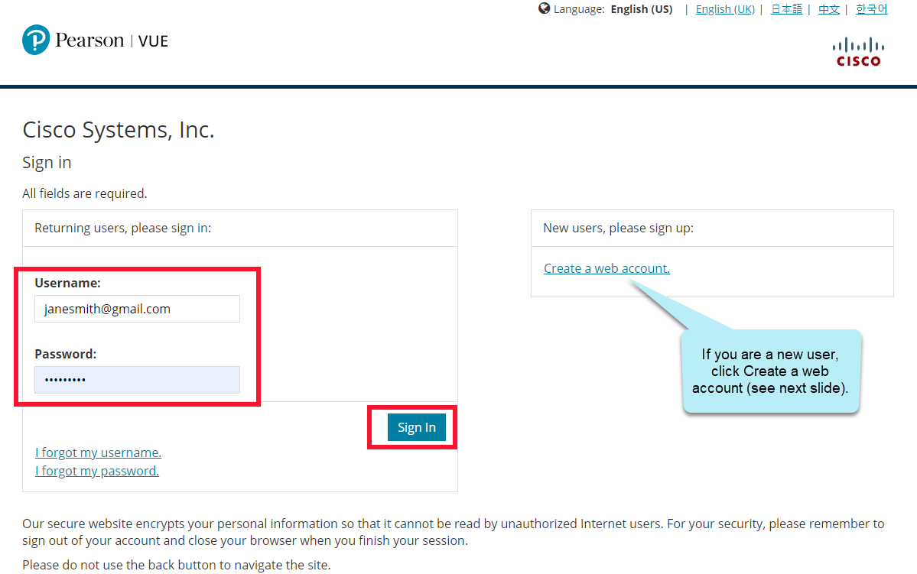
6a. Login to Pearson VUE
Go to the Pearson VUE website
Enter Username
Enter Password
Click Sign In

Slide 14
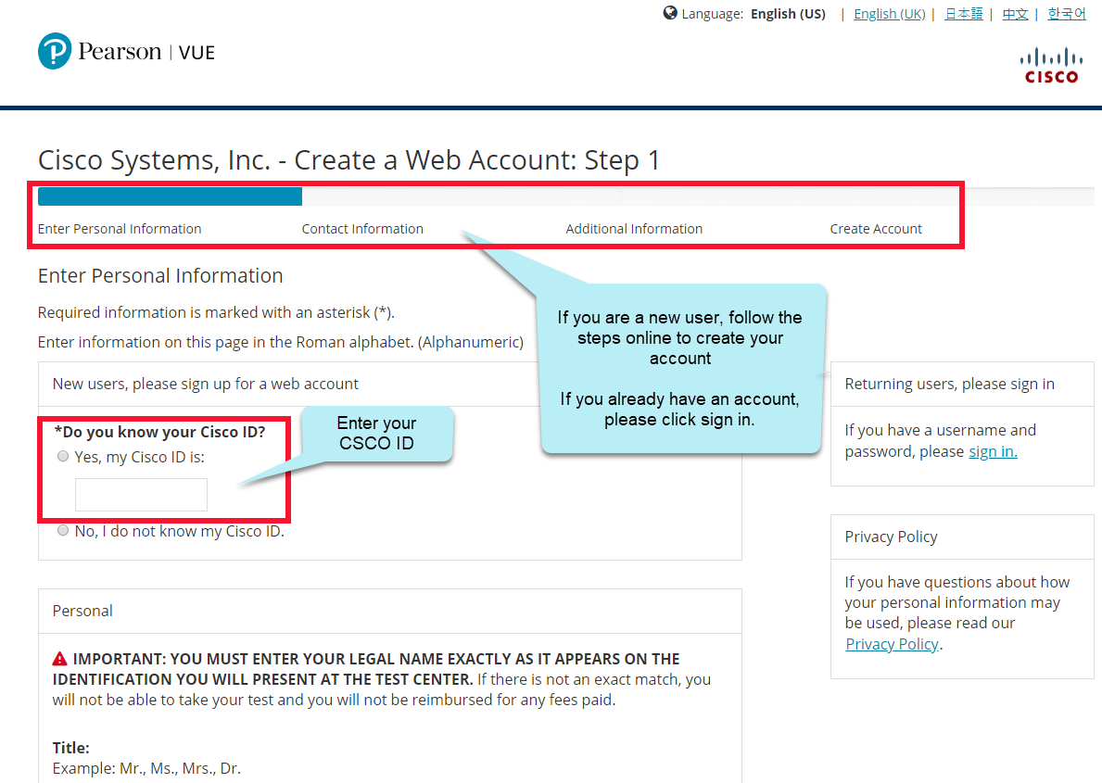
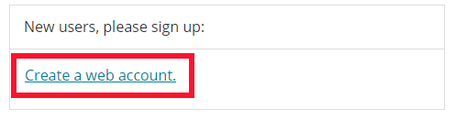
6b.Create account at Pearson Vue
Click Create a web account
Enter Personal Information
Enter Contact Information
Enter Additional Information
Create Account
Agree to Privacy Policy Acceptance
Note: It is critical that the information you enter to create your account is exactly the same as the information in the Exam Discount Information email, i.e. your name, email address, CSCO ID, Academy Connection ID. If you enter the information incorrectly, you will not receive your discount.

Slide 15
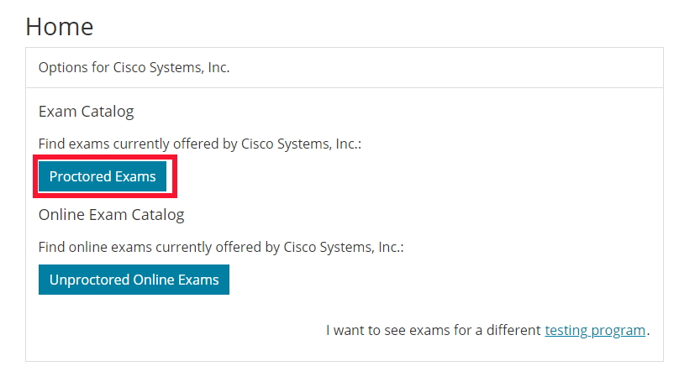
7. Schedule Exam through Pearson VUE
Click Proctored Exams
Search by exam code or name
Follow online instructions
Select Test Center
Choose appointment date & time

Slide 16
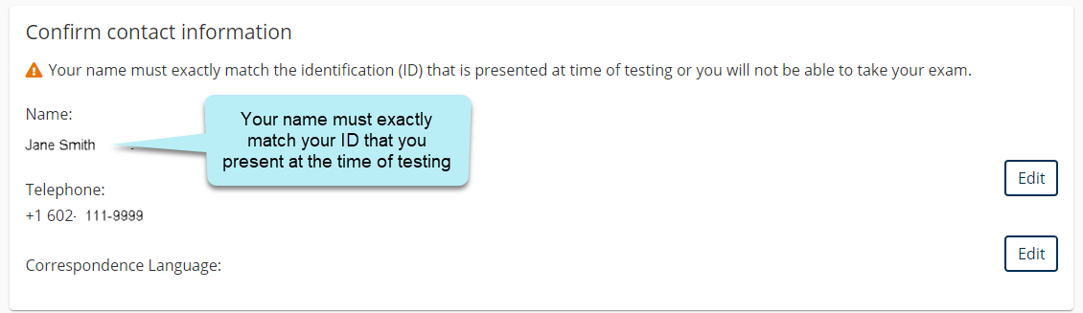
8. Review Exam & Appointment Details
Review Exam & Appointment Details
Confirm name matches ID
Review & Agree to policies

Slide 17
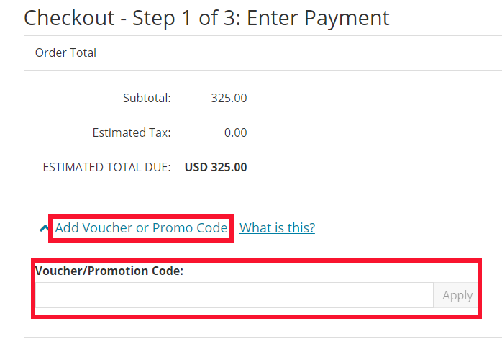
9. Add Promo Code
Click the add Voucher or Promo Code link
Enter the Promo code and click apply
Review all information
Click Submit Order

Slide 18
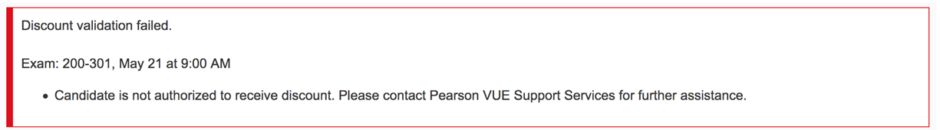
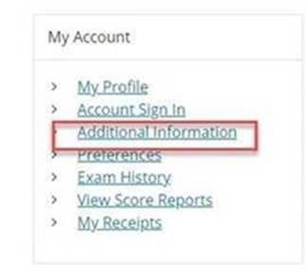
PearsonVUE Error
If you receive an error when entering the promo code at PearsonVUE, please check the following:
NetAcad ID in PearsonVUE Profile: Validate your Networking Academy ID displays in your PearsonVUE profile by clicking on “additional information”. Your Networking Academy ID can be found in “My Profile” in NetAcad.com
2. Duplicate CSCO IDs: Open a ticket to merge your duplicate CSCO IDs https://ciscocert.secure.force.com/english. They will be able to merge the accounts within 3-5 business days.

Slide 19
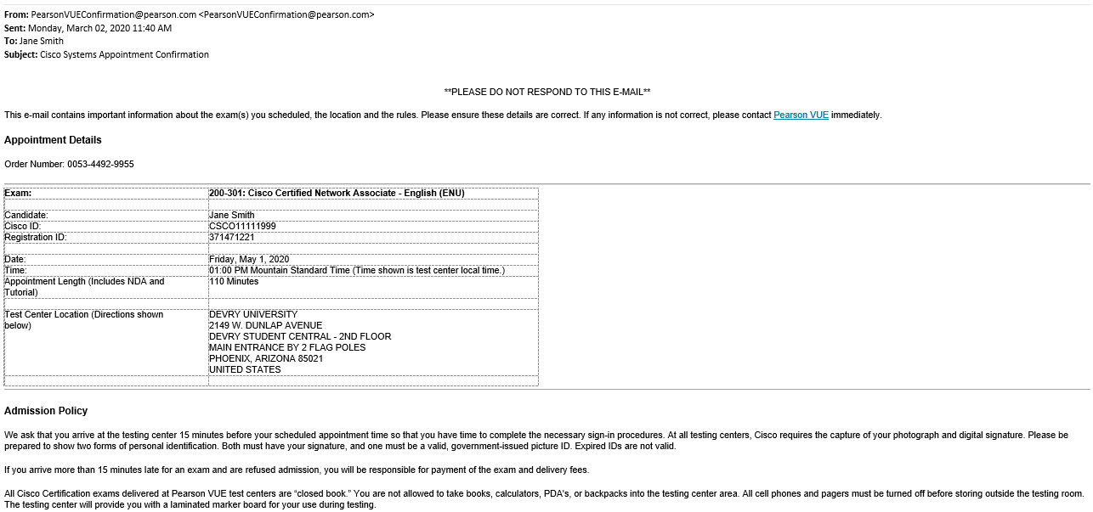
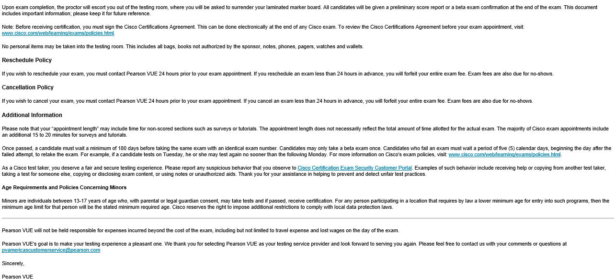
10. Testing Appointment Confirmation Email
Review Exam Details
Review Admission Policy
Directions to Test Center
Review other information

Slide 20
NetAcad Certification Exam Discount Eligibility Criteria
To qualify for a NetAcad Certification Exam Discount, Networking Academy students must meet the following criteria:
For CCNA v6 or earlier Connecting Networks and CCNA Cybersecurity Operations
For CCNA v7 Enterprise Networking, Security, and Automation, CyberOps Associate, and DevNet Associate
75% or higher on first attempt of qualifying course final exam
Marked “Complete” in the NetAcad.com grade book
NetAcad Certification Exam Discount
70% or higher on first attempt of qualifying course final exam
Marked “Complete” in the NetAcad.com grade book
NetAcad Certification Exam Discount

Slide 21
NetAcad Certification Exam Discount Policies
Discount Availability Period
Discounts must be requested within the limited validity period. To use this discount you must go through and complete the discount request process and take the exam before the expiration date. You must request, use your discount and take your exam before the expiration date.
NetAcad Certification Exam Discounts may not be sold. They are for the sole use of Networking Academy students and instructors who have met the eligibility criteria outlined by Cisco Networking Academy.
Individuals or Cisco affiliated partners who use NetAcad Certification Exam Discounts or promotional codes that are fraudulent or otherwise obtained from an unauthorized source (including legitimate discounts for attempted re-use) may risk up to and including a lifetime ban on all future exams, the nullification of all previous certifications or other program sanctions at the discretion of Cisco.
Cisco will not compensate candidates for fraudulent discounts or discounts obtained from an unauthorized source.
Networking Academy Community Member (Student, Instructors, Instructor Trainers and Administrators) who are found to be involved in NetAcad Certification Exam Discounts fraud risk their deactivation from Networking Academy and the deactivation of their Academy from Cisco Networking Academy without notice.
Exam discounts must be used in the same region where you completed your Networking Academy training.
Exam discounts must be redeemed by the expiration date. No extensions or exchanges will be given.
Cisco cannot make changes to discount requests after they have been submitted.
The NetAcad Certification Exam Discount is valid for one use only. Students who fail the certification exam will not be issued a second exam discount.
NetAcad Certification Exam Discounts are subject to change and from time to time validity periods and exam prices also change. These changes occur without notice. Please request and redeem your discount in a timely manner to avoid being affected by any changes.
Discount eligibility indicates success with a Network Academy course. It does not guarantee a passing score in the Certification exam. Cisco encourages you to prepare well for the Certification Exam to maximize your chances of passing.

